Slide 1
Program Configuration
When you create a new program in Android Studio that will generate some codes to configure your program to work, we modify these codes to give our application some of the access and basics it needs, and it will be in the XML language

Slide 2
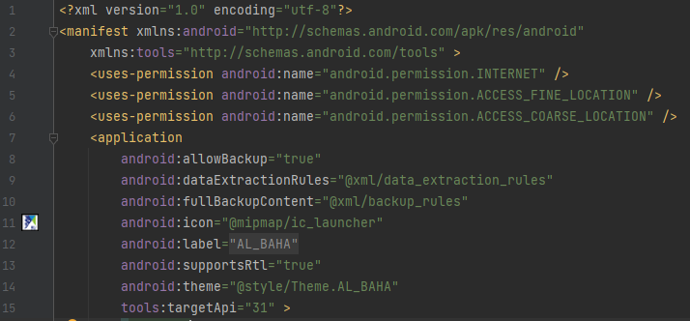
Configure the application

Slide 3
1 – Using XML version 1.0, with utf-8 encryption
2 - By opening the basic tag, we give the application the access to obtain the basic features of the Android system + the location of these features
3- Give the application the access to use Android tools in Android Studio + the location of these tools
4 - Give the application the access to use the Internet in the Android device
5 + 6 – Give the app the access to find the location of the device
8 – Activate backup data
9 - A set of rules for converting text to XML + location of these rules
10 – Create more than one backup copy of program files and processes
11- Image location of the application image
12 – Application Name
13 – Activating the text that starts from right to left, such as the Arabic language 14 - Take the design of the program via the following link
15 - API version to run the program on several copies of the old and new Android, the higher the number, the more the application works on more than one version

Slide 4
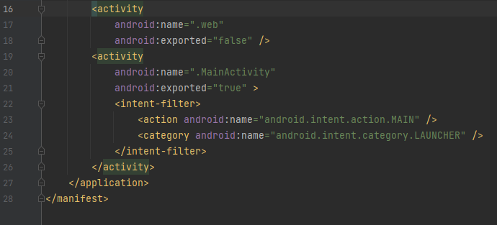
Configure the application

Slide 5
17 + 18 –The second template (browser) cannot be opened through external links and applications
20 + 21 – The first template (induction) can be opened via external links and applications
23 + 24 – When you run the program, a new activity will be created by showing the first template

Slide 6
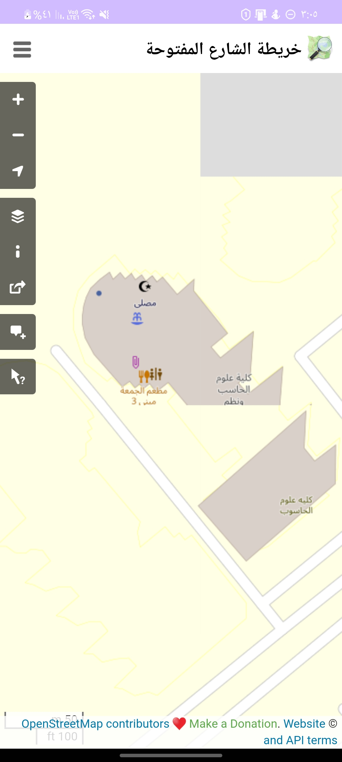

The program contains two templates
The second template is a browser
First is a welcome template

Slide 7
For each template the code consists of two main languages
XML Section
Java Department
For interface design and also is considered the basic code.
To write functions

Slide 8

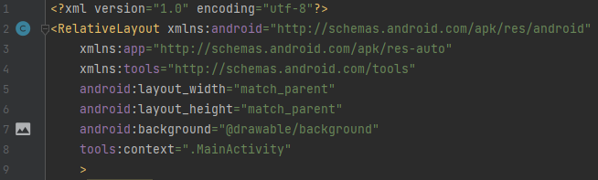
First XML template

Slide 9
2 + 3 + 4 – By opening the relativeLayout tag, everything will be integrated within the boundaries of the screen and the possibility of modifying it + giving permission to obtain Android features and tools
5 – Make the width like the width of the screen
6 – Make the length like the length of the screen
7 – Give an image as a background for this template + image location
8 – Template Name

Slide 10
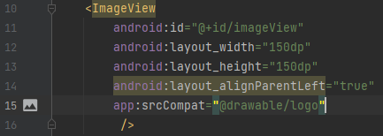

First XML template

Slide 11
10- Special tag for photos
11 – Tag Name
12 – 150 pixels wide
13 – 150 pixels long
14 – Make the basis of this image on the far left
15 – Photo location

Slide 12
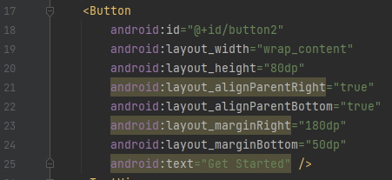
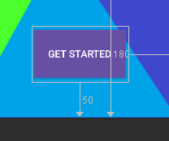
First XML template

Slide 13
17 – Special tag for button creation
18 – Button Name
19 – Button width and appropriate with text display
20 – Button length
21 – Its basis is on the far right
22 – Its basis is at the bottom
23 - Move the button from the right 180 pxels
24 – Move the button from the bottom 50 pixels
25 – Text inside the button

Slide 14
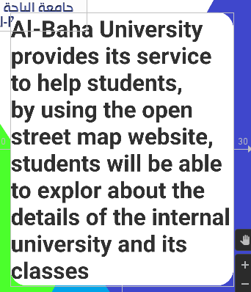
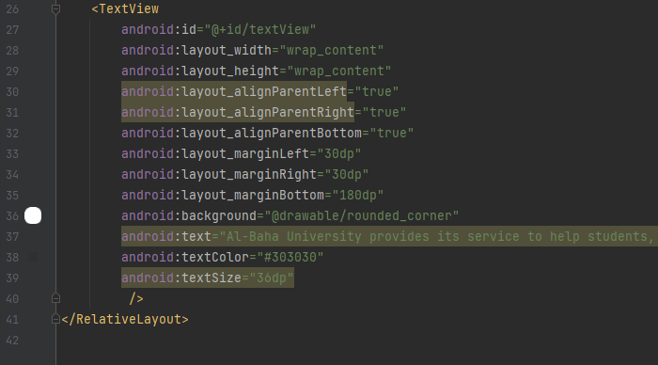
First XML template

Slide 15
26 – Special tag for creating text
27 – Text Name
28 + 29 – Make the length and width of this text appropriate to the length and width of the content
30 + 31 + 32 – Make the basis of this text at the far left, right and bottom
33 – Move text from the left 30 pixels
34 – Move text from the right 30 pixels
35 – Move text from the bottom 180 pixels
36 – Background characteristics of the text and its location (these characteristics are a set of codes that can be reused more than once, but written once)
37 – Writing the text
38 – Text color
39 – Text size, which is 36 pixels per character

Slide 16
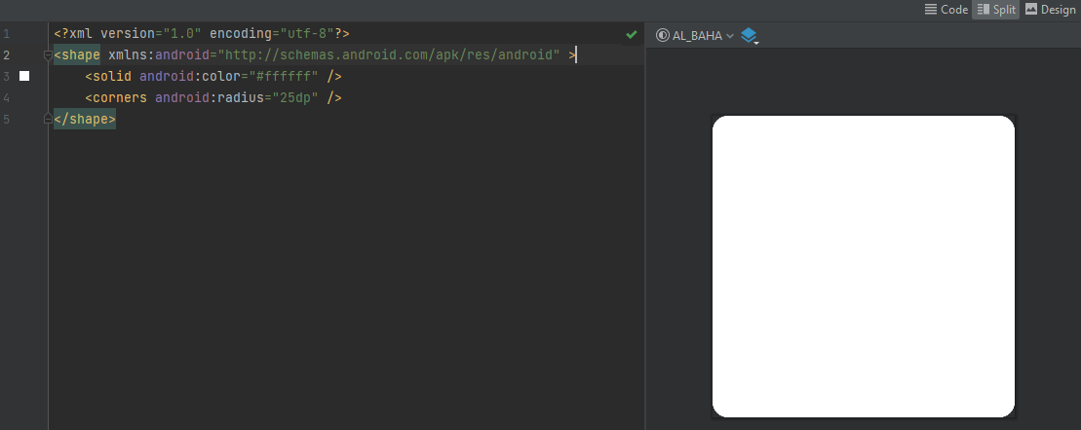
Rounded conner properties

Slide 17
2- We put a tag shape to create a shape
3 – This shape will be of the type of solid and in white
4 – The angle of this shape is curved by 25 pixels

Slide 18
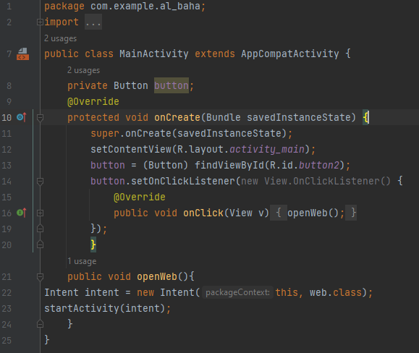
First template, Java

Slide 19
1 - From the package or Albaha University application files
2 – Calling some predatory libraries
7 – We start by creating the class on the name of the template and start modifying it and putting the functions
8 – We created a virtual button called Button
10 + 11 is where to put the functions, onCreate is a class that detects all the processes and events performed by the user (such as pressing the button, dragging the screen, etc.) The savedInsatnceState saves and logs these events
12 – Putting monitoring and discovering processes and events in the first template
13 – Link the default button as the same button in the first template by giving it the same name or ID
14 – This button is pushable
16 - When you press, activate the following activity named (openweb),
21 – We create a new class with the same name as the activity to call it
22- Upon call, the activity will open the second template (browser)
23- The activity started immediately

Slide 20
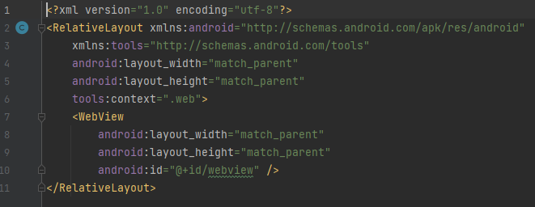
Second XML template

Slide 21
4+5 – The length and width of the template are the same as the length and width of the screen
6 – Template Name
7 – tag to create a browser
8 + 9 the length and width of the browser with the same length and width of the screen
10- Browser name

Slide 22
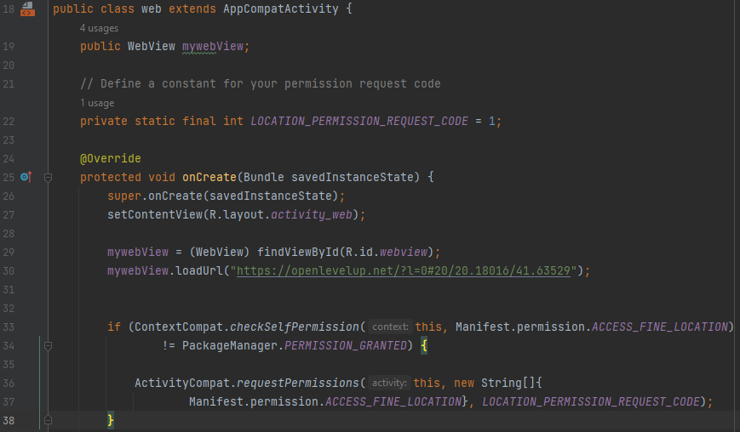
Second template java

Slide 23
19- Create a class with the same name as the template
20 – Create a virtual browser
23 – Giving the request for access to the site a distinctive value, this value has no meaning and can add any value as long as it is distinct from any other request, such as requesting access to files or requesting access to contact log information, etc.
28 – Be monitoring and tracking events in the second template (browser)
30 - Linking the virtual browser to the browser in the second template via the id
31 - The default site when opening the browser, which is open level up, specifically on Al-Baha University
34 + 35 – Condition, checked in the record and data of the application if it does not give a notification to the user requesting access to the requirements, if it was previously notified, the condition can be skipped and the code completed, if the user has not been previously notified of a request, he will complete the code below.
36 + 37 – Upon fulfillment of the condition, the user application will be notified of the request to access the site with the value of this special request.

Slide 24
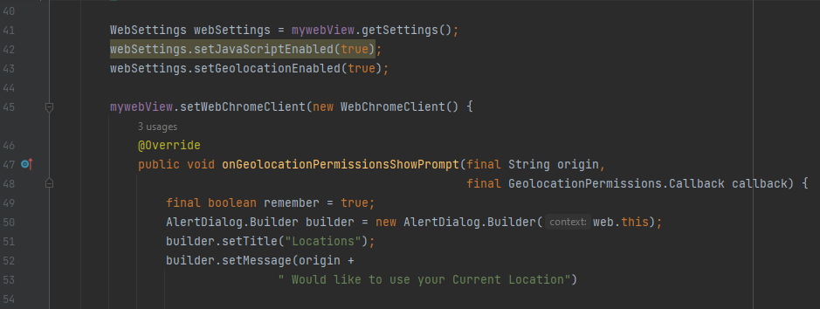
Second template java

Slide 25
41 – Definition of a value for modification on the browser
42 - Activating JavaScript, which is important for the work of maps and programs within sites, such as Google Map and OSM/OLU map
43 – Enable current location data
45 - Definition of using one of the components of the Android system, setWebChromeClient It replaces the regular browser with a browser that exploits the capabilities of JavaScript and it is important for determining the location, as the regular browser does not use or exploit JavaCript even with it activated.
47 - The creation of the notice starts from here in the name of obtaining site data, this notice is intended for the browser to obtain access to the device's site, not the program itself, and also the browser will directly reject the access request if the site is not secured, that is, it does not start with http.
49 – Activate browser remembering The user's response to the request of this site.
50 – Create and build notification in the browser
51- The name of the notice will be locations.
52 – Notification message = site name then + (wants to access your current location)

Slide 26
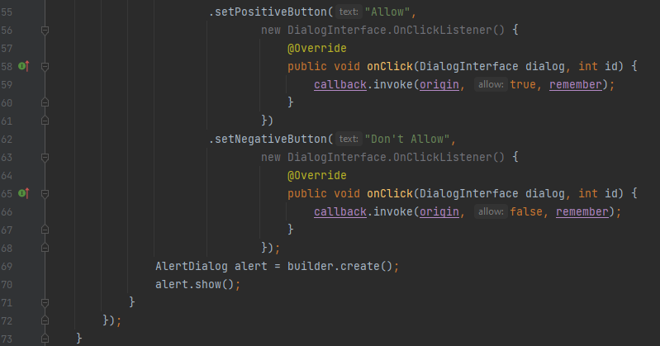
. Second template java

Slide 27
55- Add a "positive" button to the notification as allow
56 – The button is pushable
58+59 – When pressed, the location will be allowed for the site to access the device's location + this choice will be remembered.
62- Add a "negative" button to the notification as don't allow
63 – Pushable button
65 + 66 - When pressing will not allow the site to access the location of the device + will remember this selection.
69- Create an identifier named alert of the type AlertDialog, which is the type of notification that can place the name and message and creating up to 3 buttons
70 – Show this notification on the screen

Slide 28

Application image

Slide 29
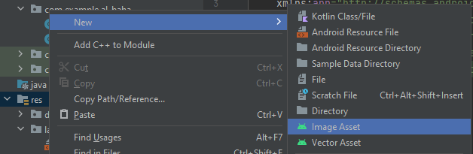
We did not use or write any code to customize the application image, but we used a tool that helps to format the application image
The image of the application in Android can be divided into 3 layers, but we were satisfied with putting only one layer ,The name of the tool is image asset, and it can be opened by pressing the right button in the res file, Then new then image asset.

Slide 30
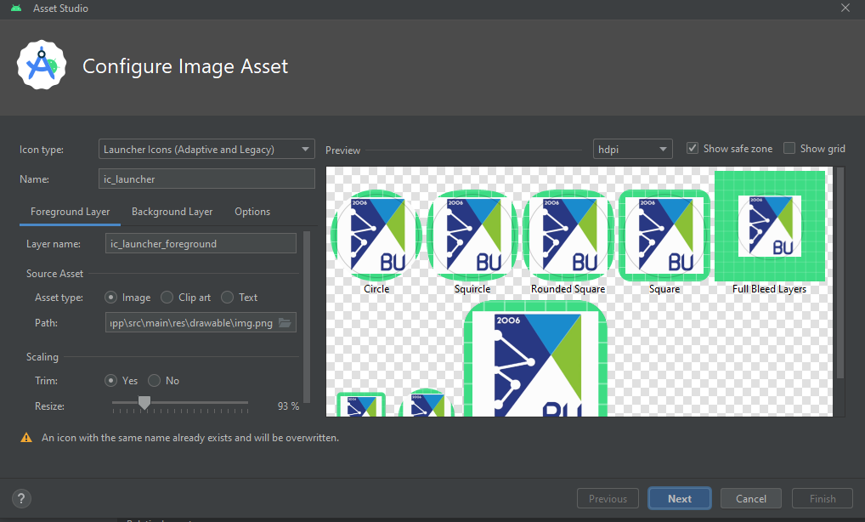
Inside the tool, images and layers can be added in the application image, and adjusted in size and formatting

